Slide 1
Laptop Diagnosis
By
Praveen Kumar G
Under the guidance of
Prof. Srinivas Babji

Slide 2
Existing System
Suppose customer purchased a laptop from a company. She/he/Organization may come across various technical problems while using the product.
Generally customers don’t know the name of the sites of all the organizations to post their problem.
Customers usually face some problems while posting their problems occurred as they have to post their queries and problems to different sites individually.
There is no surety of quick response from the vendors. Few vendors may not be interested in responding to the customer’s problems.

Slide 3
Proposed System
The purpose of the project “Laptop Diagnosis” is to provide support for the customers who are facing problems with various Laptops.
So in order to overcome all these limitations and to meet all their requirements, the current processes are replaced with this application.
Customers can use this system to convey the problem to the concerned seller online and get his problem solved.
This system provides easy to use interface through which the customer can get technical support.

Slide 4
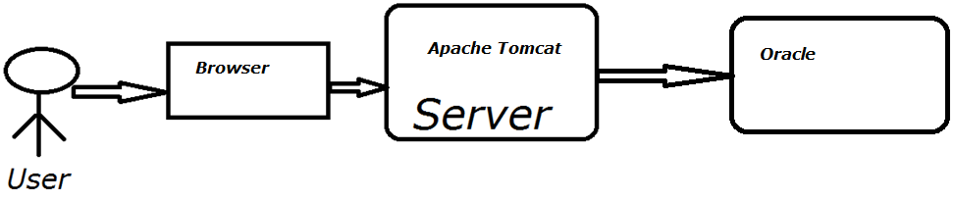
Architecture

Slide 5
Modules
Customer module
Tech Person module
Manager module
Admin module

Slide 6
Software & Hardware Requirements
Java
Apache Tomcat Server
Oracle
NetBeans
Core i3/i5
2GB RAM
Win7/10

Slide 7
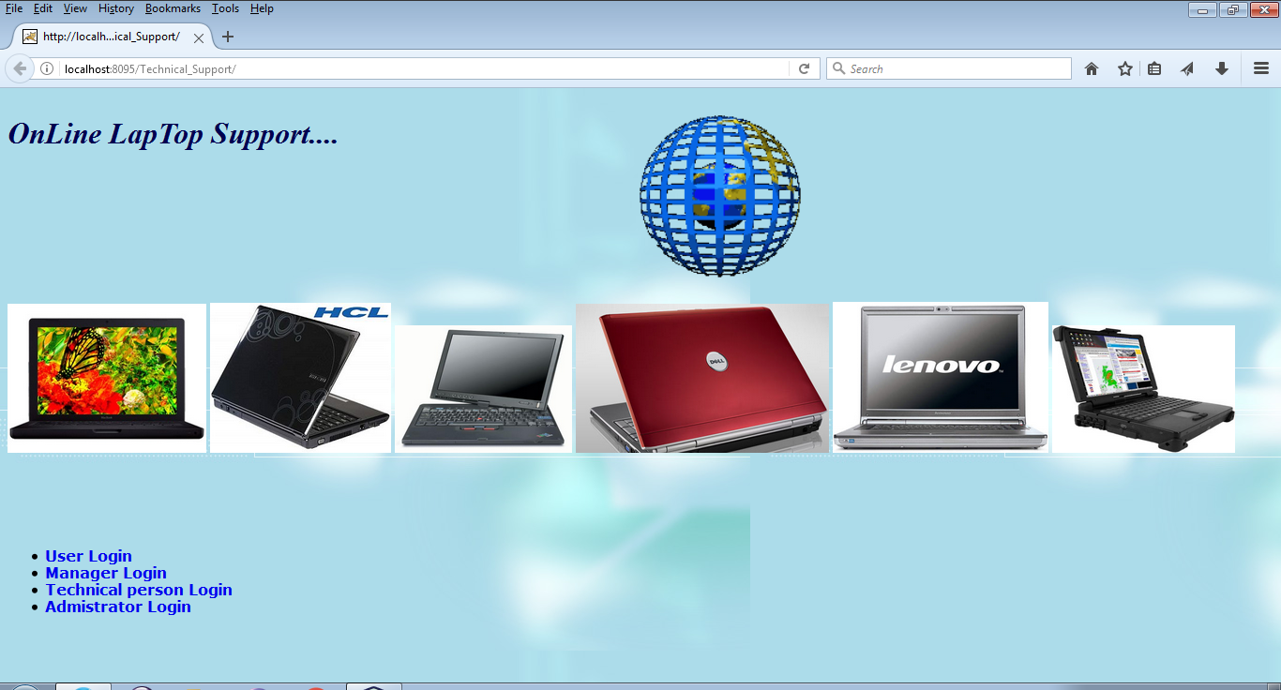
Home Screen

Slide 8
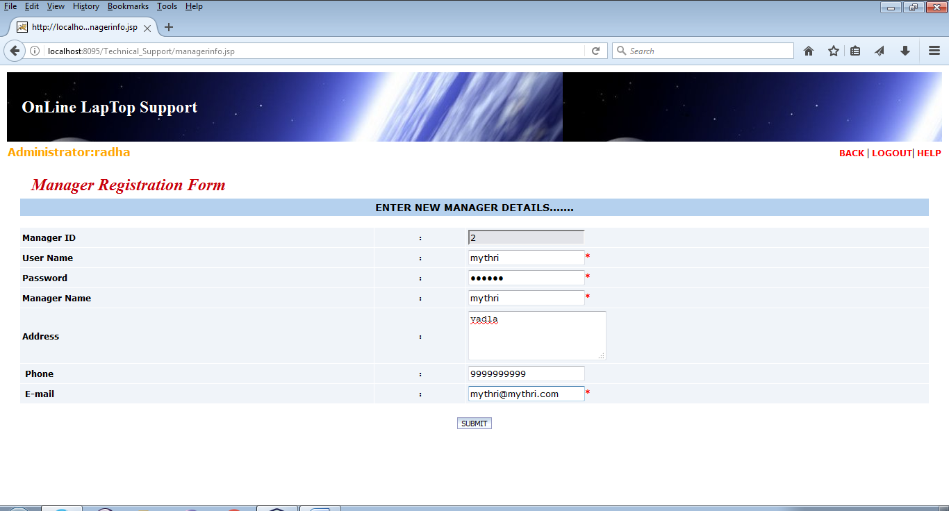
Technical manger adding Page

Slide 9
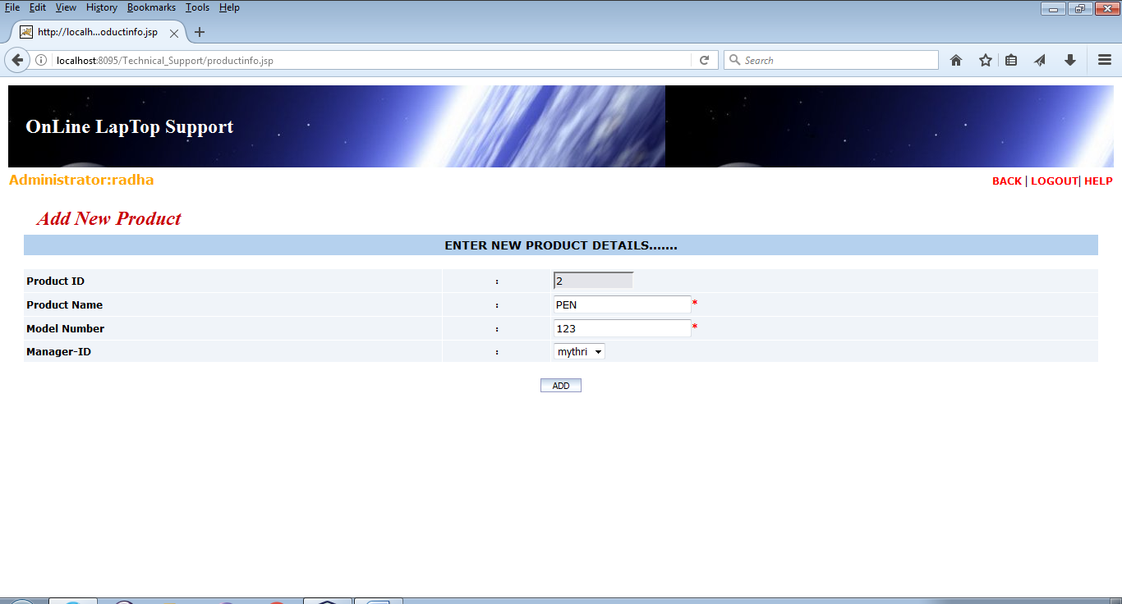
Adding Product

Slide 10
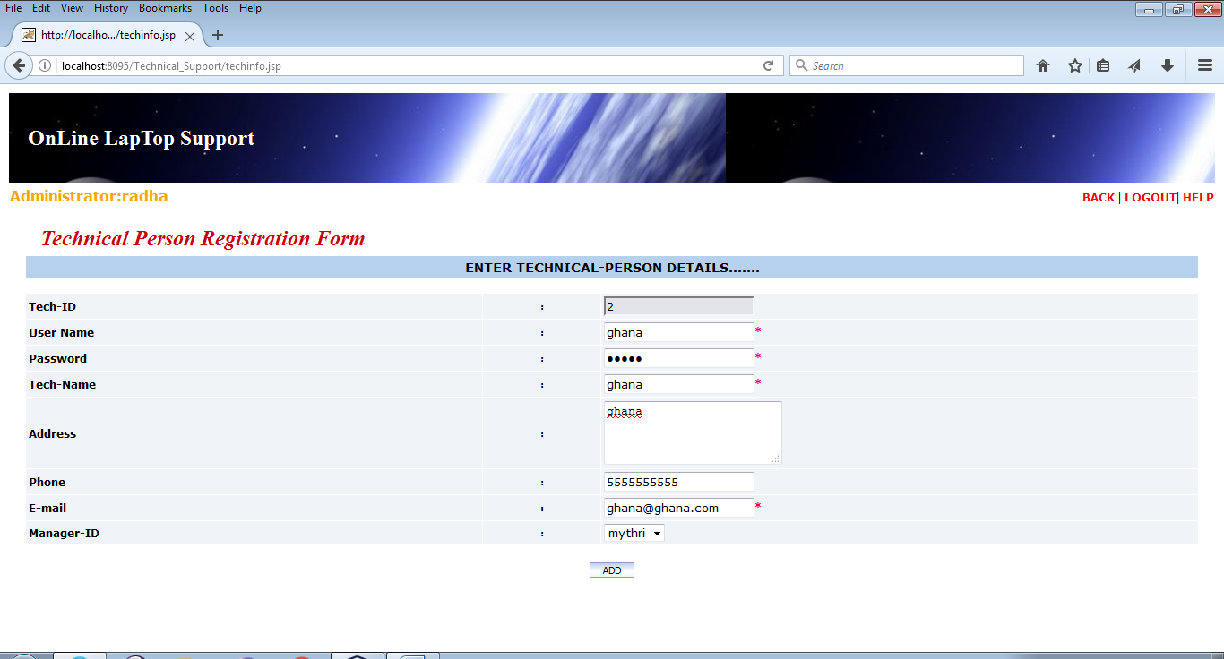
Tech Person Adding

Slide 11
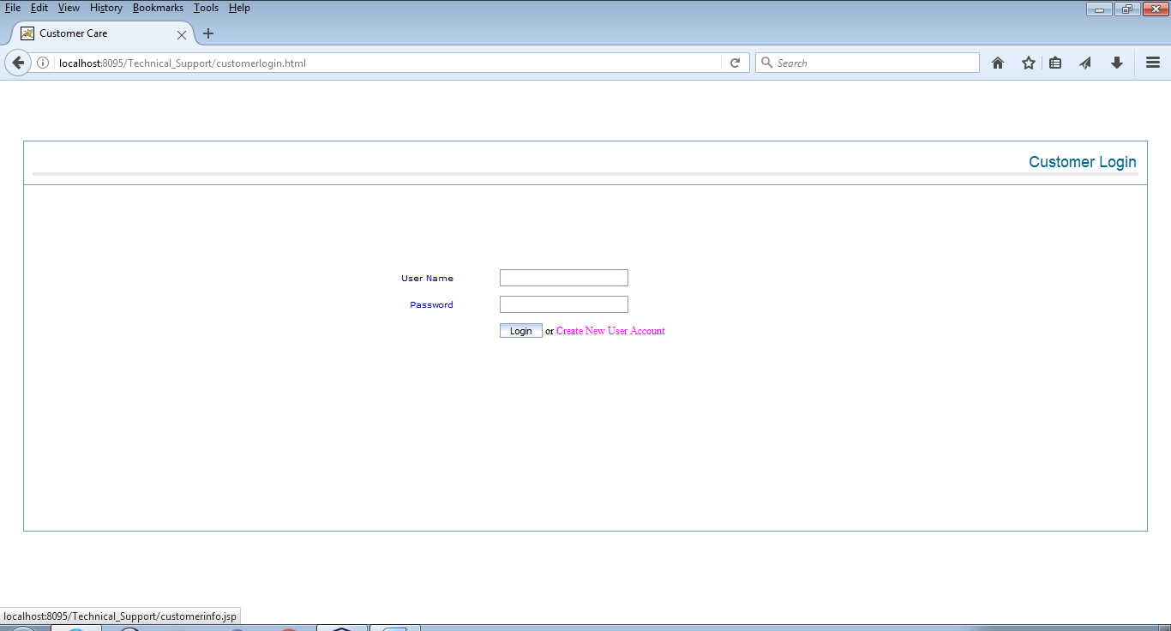
Login Page

Slide 12
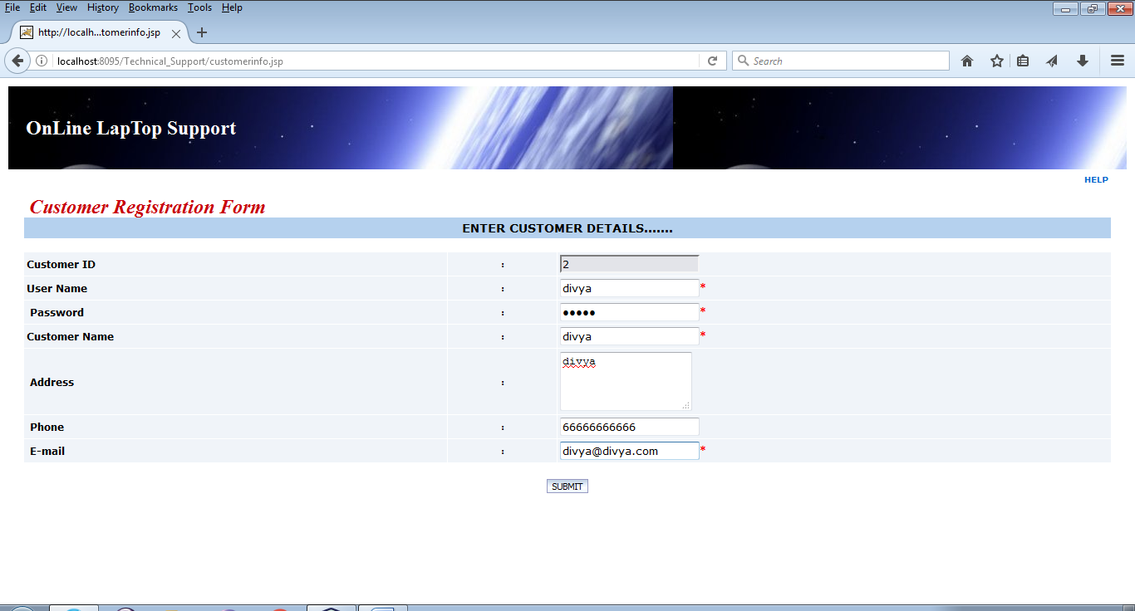
Customer Registration

Slide 13
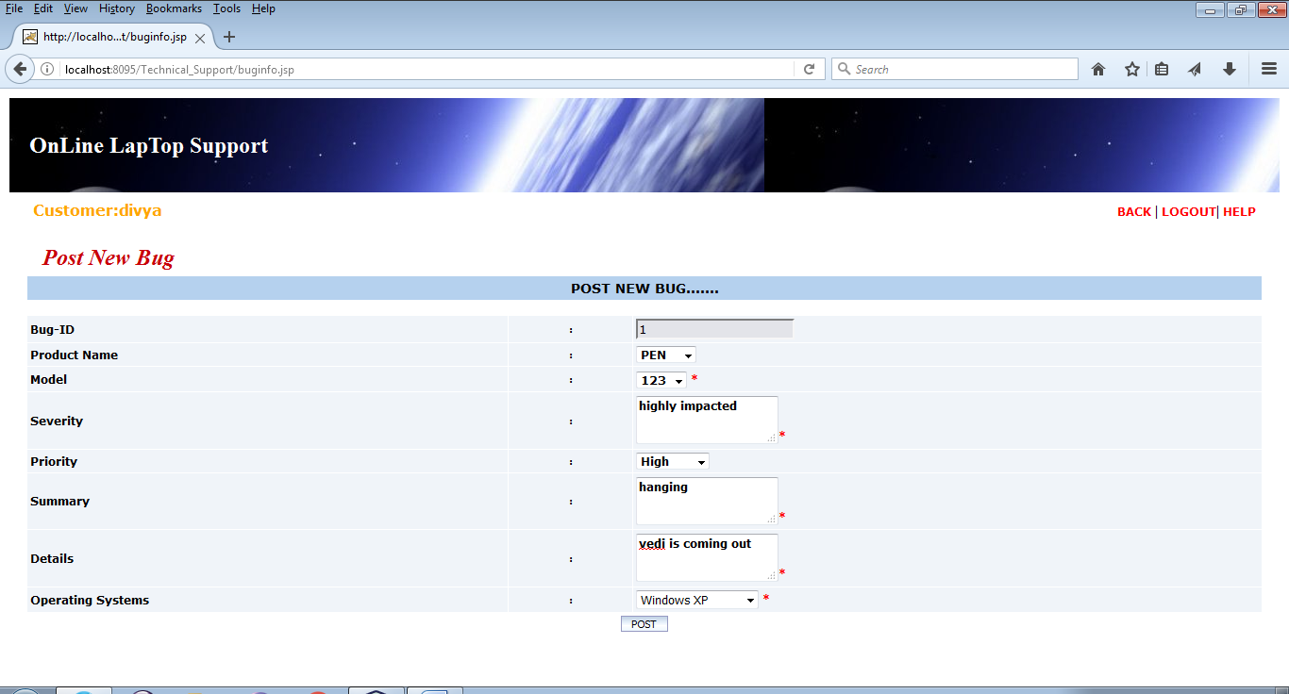
Posting the problem

Slide 14
Thank You

